Slide 1



Analysis of Car listings on Ebay
Evans and Festus

Slide 2
Problem Statement
Max has recently damaged his vehicle so he is in dire need of purchasing another vehicle either automatic or manual.
Since he is on a strict budget, he has approached us as data analysts to help him get information on ebay car listings for second-hand cars based on his budget.
As data analysts, we have agreed to provide him with insights to better assist him in his decision making and provide the best vehicle for his budget.
Notes:
Numerous data available that needs to be processed for usability
Awareness about types of vehicles that are listed for sales
Little understanding of the auto market dynamics for second hand vehicles
Goal
Investigate the underlying patterns about the data
Data wrangling - cleaning and standardizing
Checking the price variations between features
Correlation between numerical features
Visualization with Tableau Dashboard
Reveal the bigger picture for enhanced usability of the market space - Descriptive | Prescriptive

Slide 3
Goal
Source and gather information from ebay’s car listing
Investigate the underlying patterns about the cars sale enlisted on ebay
Data wrangling - cleaning and standardizing
Checking the price variations between features
Correlation between numerical features
Visualization with Tableau Dashboard.
Reveal the bigger picture for better decision making on the ebay Auto market space - Descriptive | Prescriptive
Help Max understand the market space based on budget
Draw general insights of the market that can be used by the general public

Slide 4
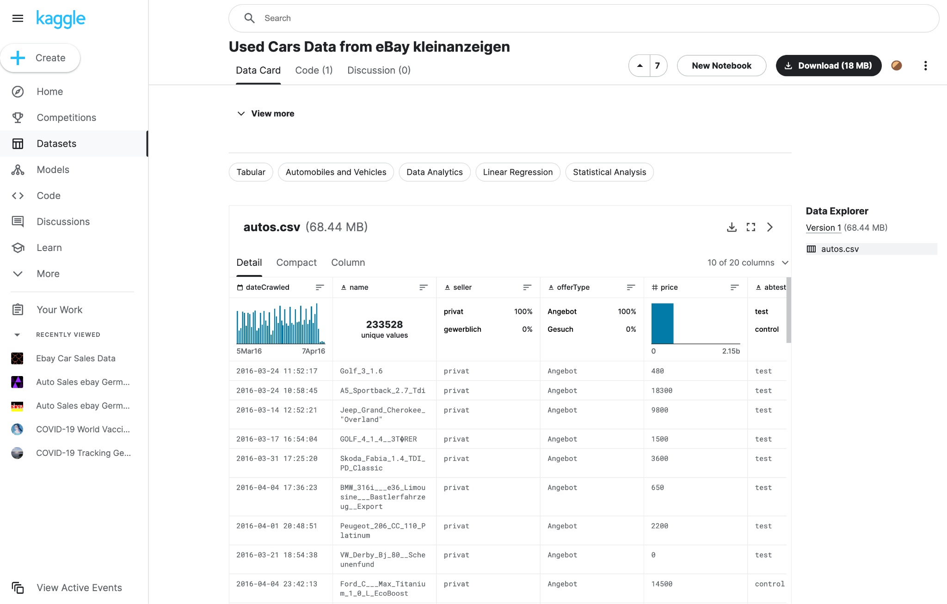
Data Gathering
(371528, 20)

Slide 5
APPROACH AND METHODS

Slide 6
Data Cleaning
Standardized all columns using - (df.columns = df.columns.str.lower())
Removed duplicates - (df = df.drop_duplicates())
Language uniformity - (df.loc[df['transmission'].str.contains('manuell'),"transmission"] = 'manual')
Dropped missing values - (df=df.dropna(subset=['transmission'])
Removed outliers using IQR and Z score
We removed from years before 1987 and retained 1988 to 2018
For price: We removed outliers that are less than 500Eur and more than 20,000Eur

Slide 7
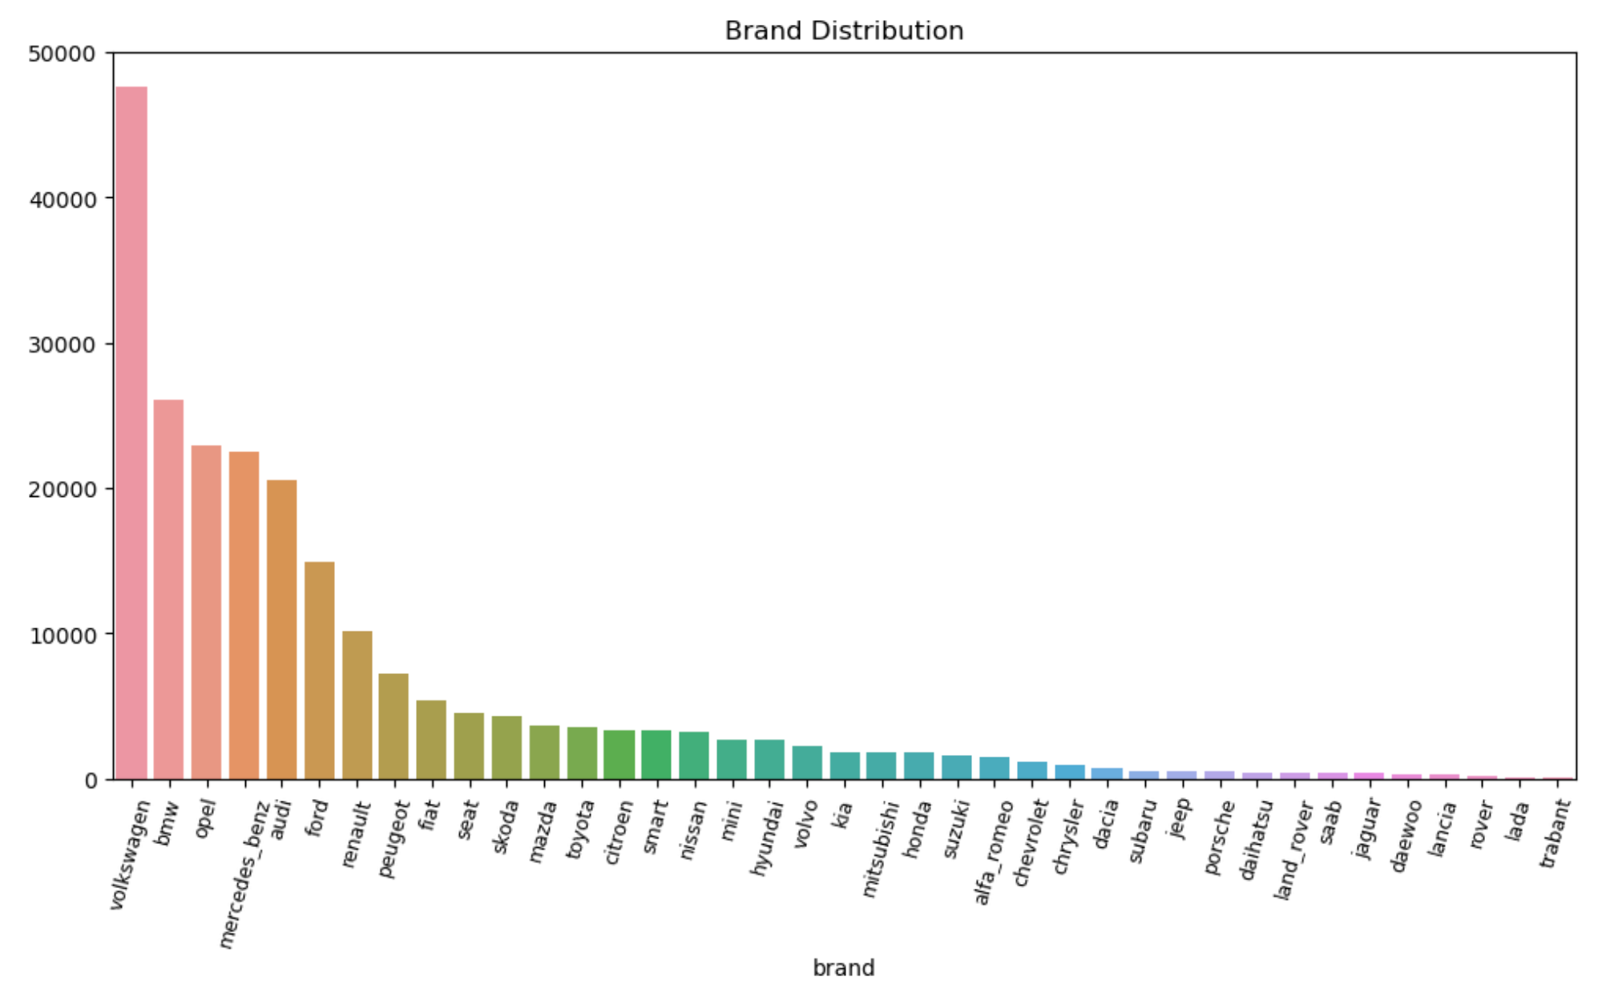
Exploratory Data Findings (I)
Counts of Brands

Slide 8
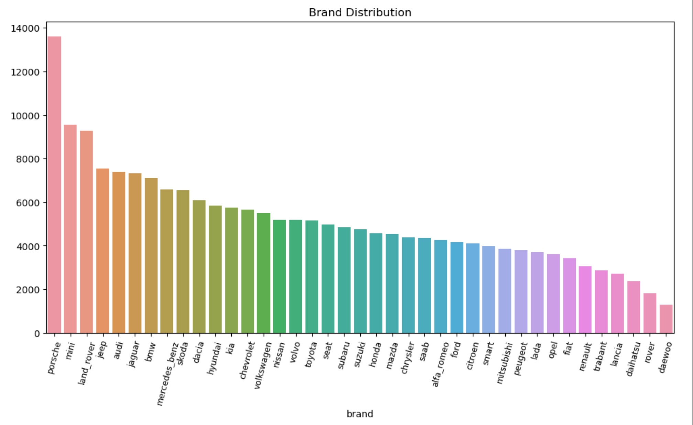
Exploratory Data Findings (II)
Prices - The mean price of vehicles is 5435Eur
Avg Price in Euros
Notes:
Prices - The mean price of vehicles is 5435Eur
Cars registered between 2000 and 2010 were more in number
Fuel_type, hybrid appears to be the most expensive, followed by electric and diesel
With price, we observe that tere is a trend of price increase between 2000 and 2015
Transmission, automatic cars are likely to attract higher prices than manual
Brand: Porsche was the most expensive vehicle followed by mini, land_rover and daewoo was least expensive
Mileage, the lower the ,mileage the less expensive. but the lowest mileage had a high price
Vehicles that are not damaged turns out to be more expensive than vehicles that are damaged.
We found strong positive correlation between price variation and year of regiszration which is 0.66 and weak negative correlation between price and mileage_km, also weak negative correlation between year of registration and mileage

Slide 9
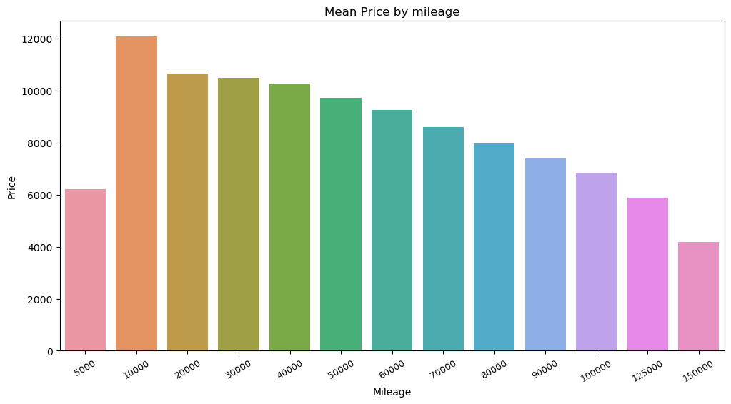
Exploratory Data Findings (III) - Mileage
Correlation = -0.41

Slide 10
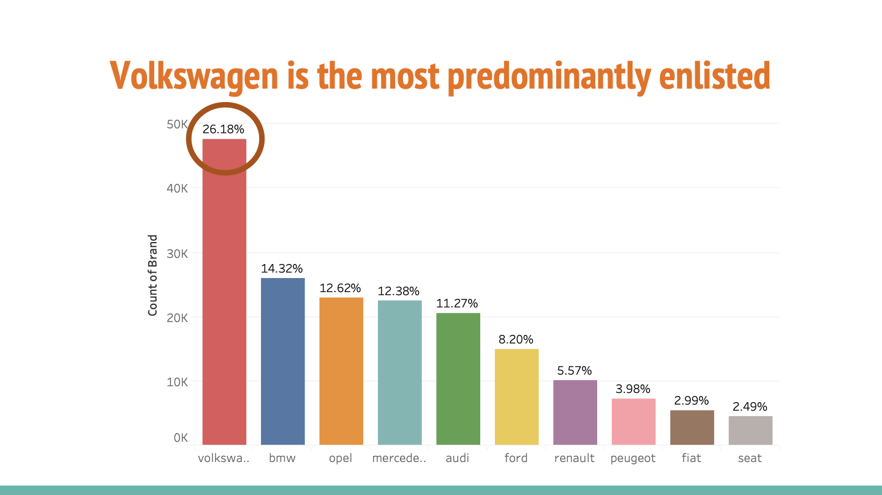

Slide 11
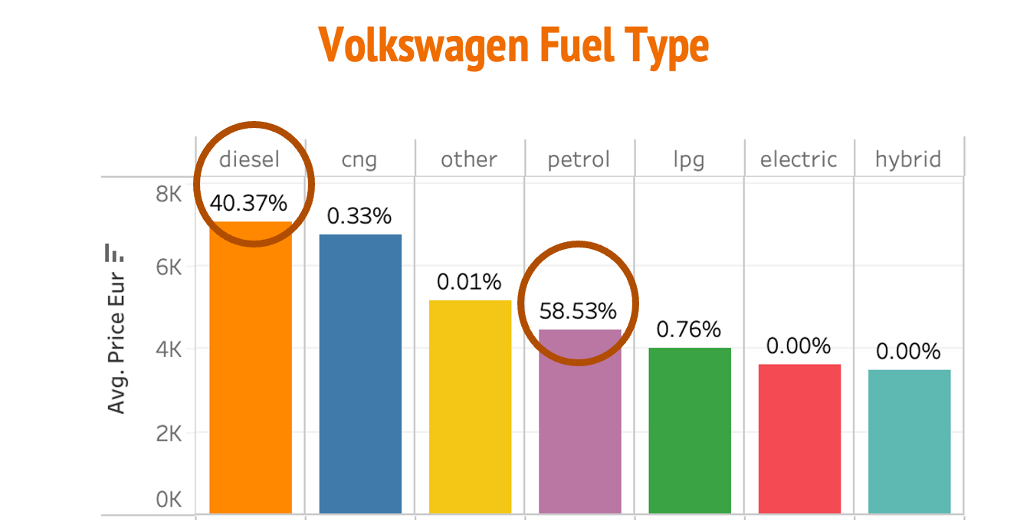

Slide 12
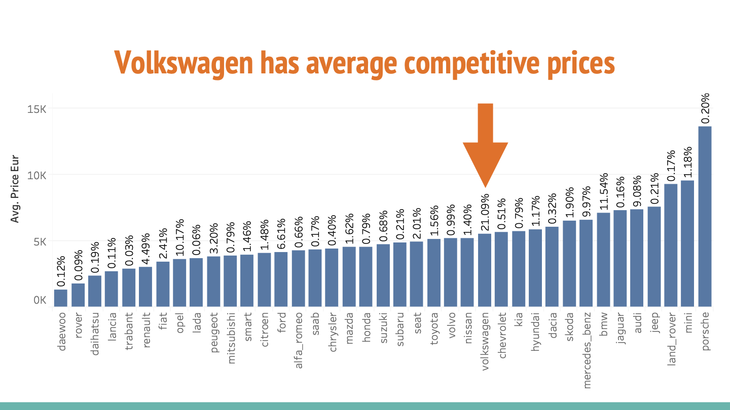

Slide 13
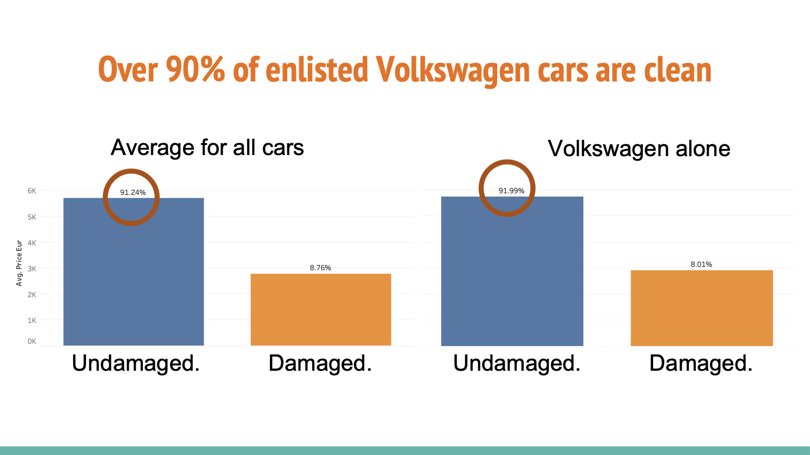

Slide 14
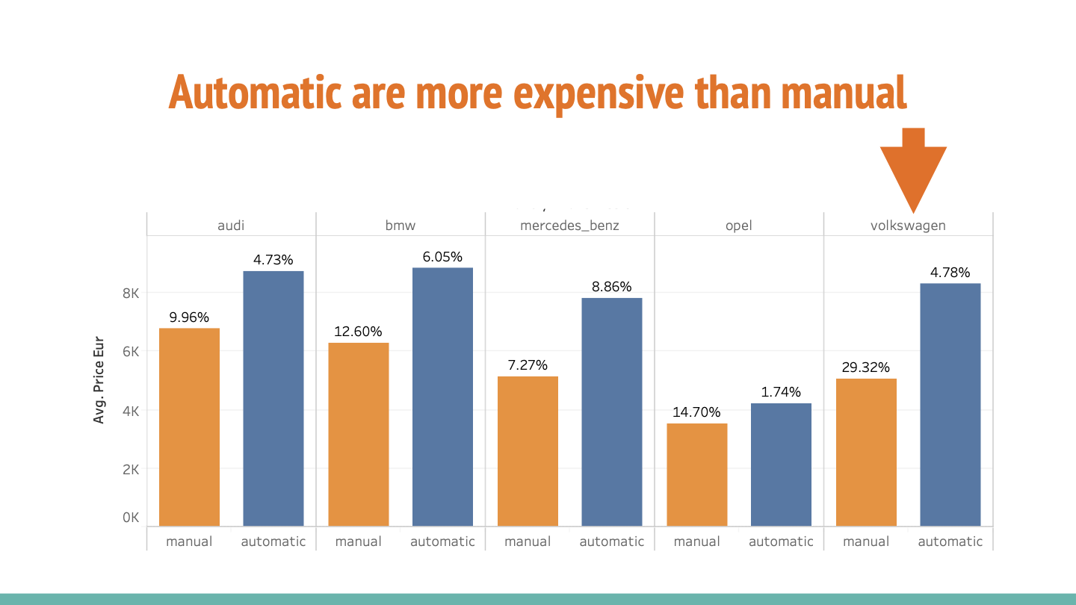

Slide 15
Max’s Decision
He disposes his damaged car at 2300€
He buys another Volkswagen, automatic car at a price of 8200€

Slide 16


Slide 17
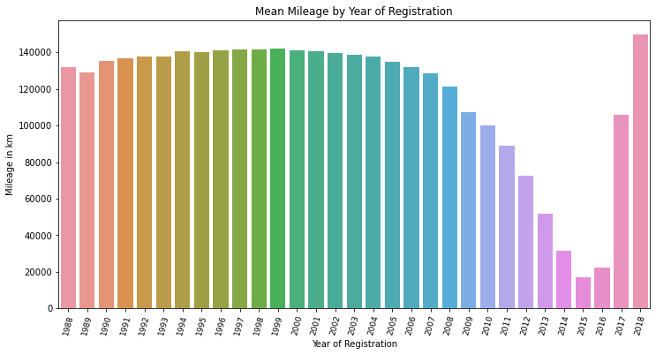
Correlation = -0.47

Slide 18
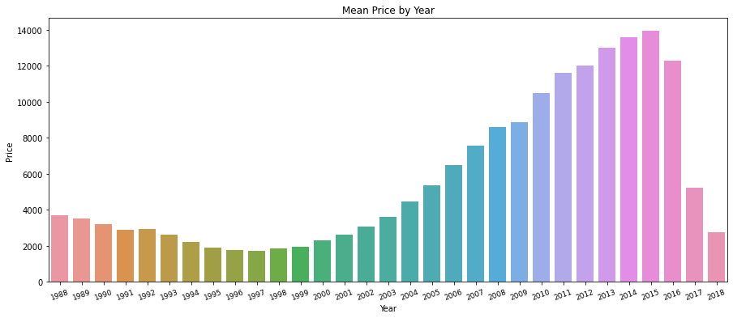
Correlation = 0.66

Slide 19
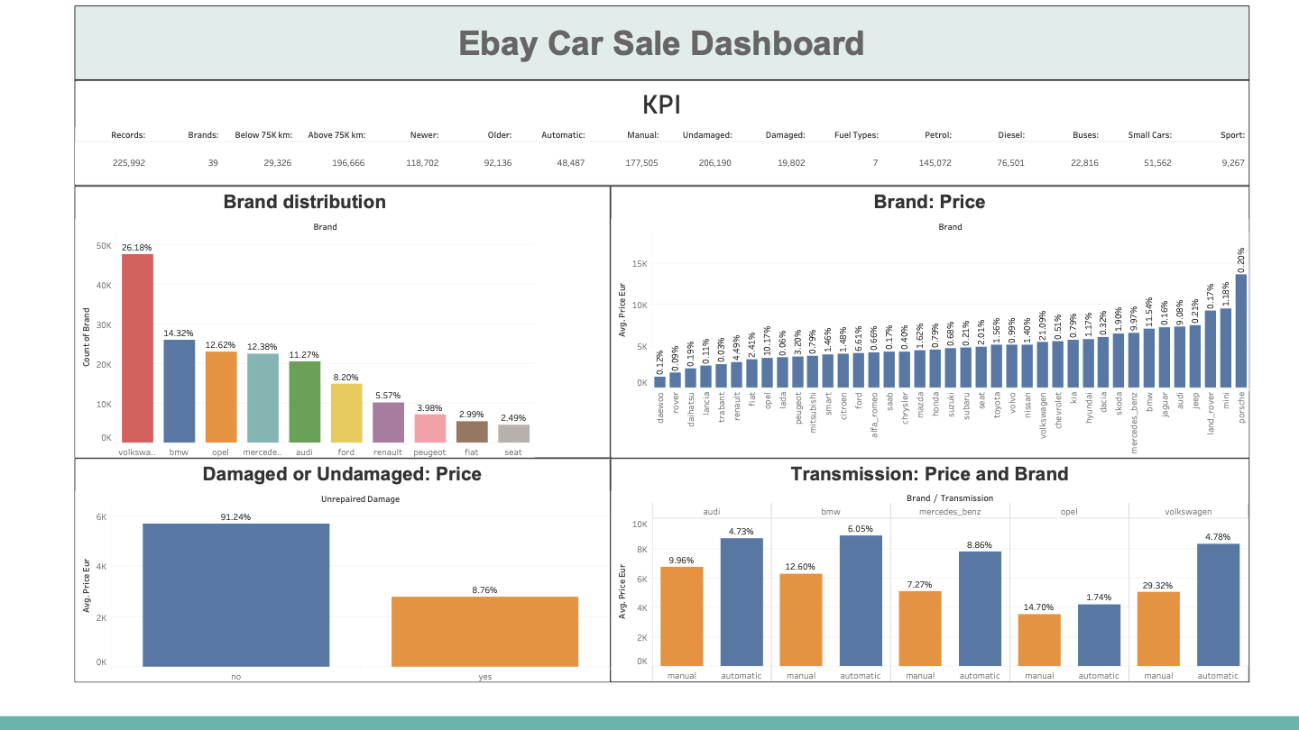

Slide 20
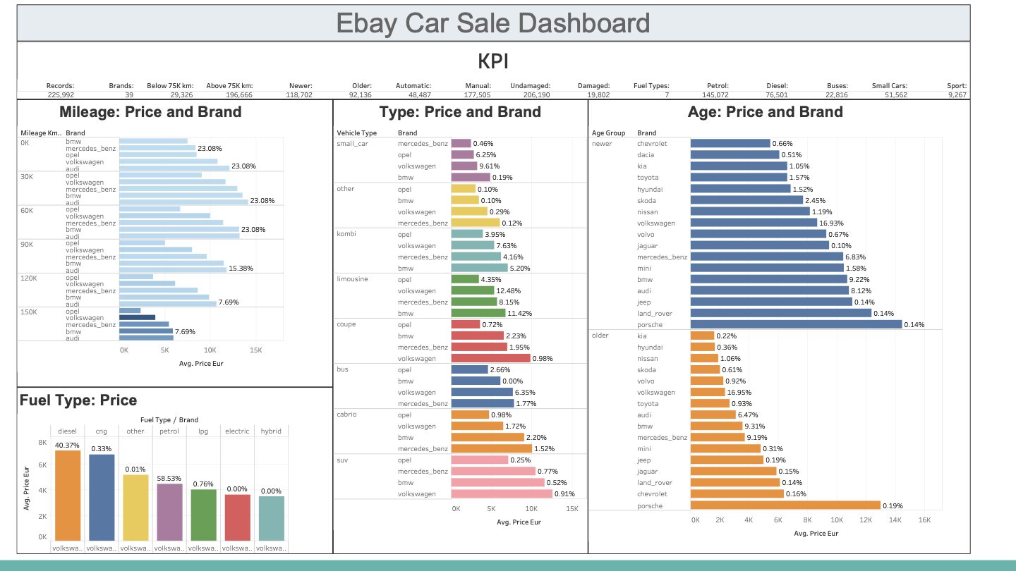

Slide 21
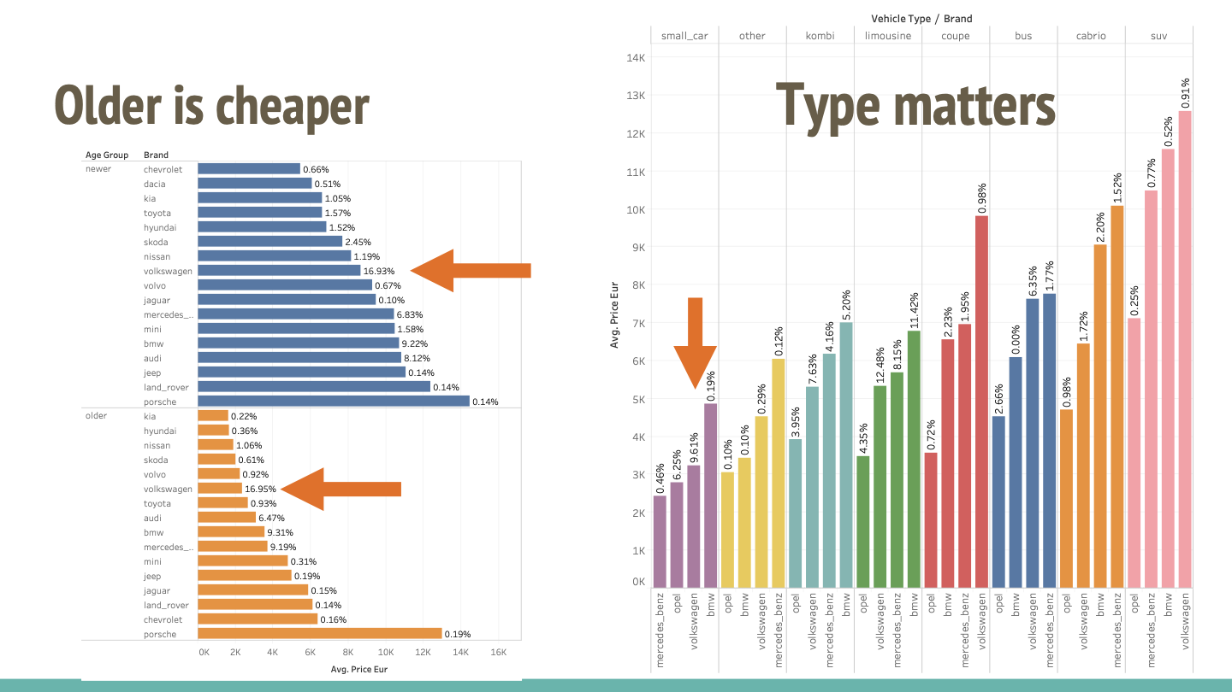
Corr = 0.66

Slide 22
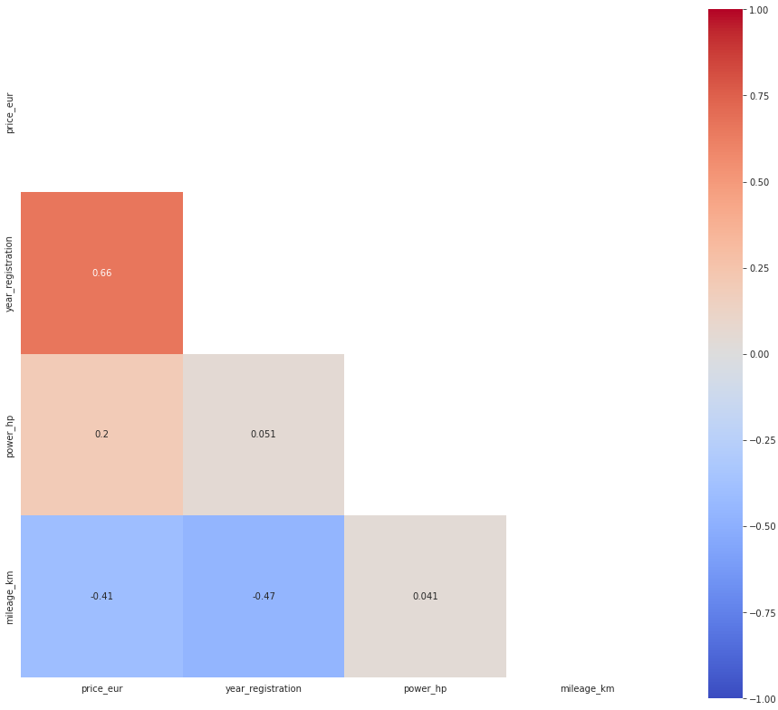

Slide 23
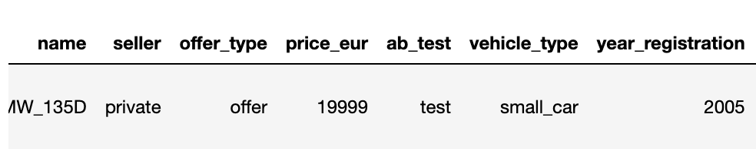

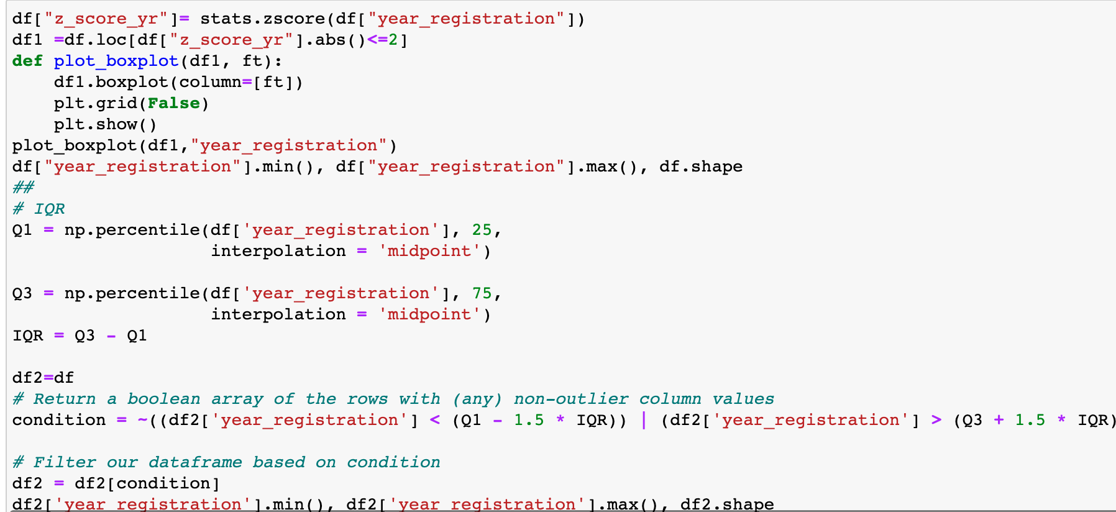
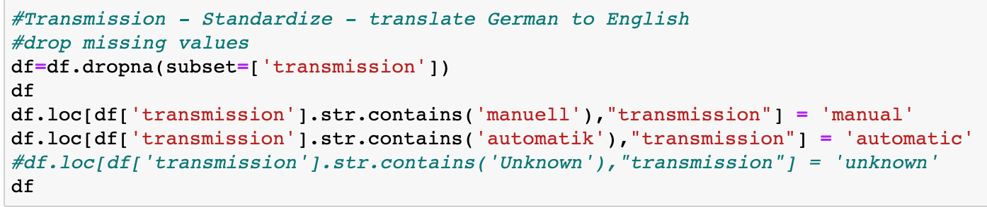
Data Cleaning
Standardized all columns
2. Removed duplicates
4. Removed Outliers
3. Uniformalized the language
Notes:
Then, we checked for dupöiacted rows where we noticed 4 dupöicated rows. We removed them
1. We also checked each columns to change German words to english for better uniformity. This was applicable in offer_type, seller, transmission, fuel_type and unrepaired damage.
1. We also checked for missing values and dropped them where applicable in specific columns
1. Worked with IQR and Z score to remove the outliers from price, year of registration
1. We removed from years before 1987 and retained 1988 to 2018
1. For price: We removed outliers that are less than 500Eur and more than 20000Eur

Slide 24
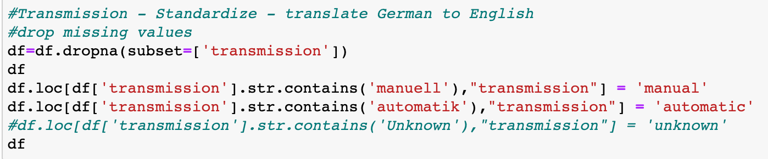
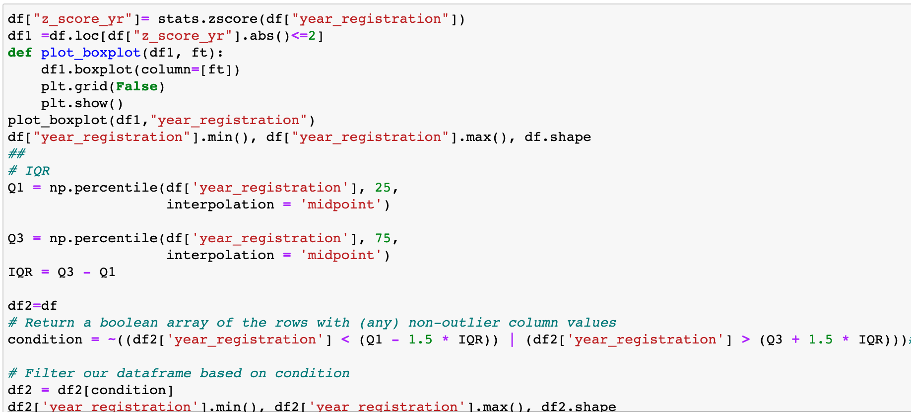
2. Data Cleaning
Removed outliers
Uniformalized the language

Slide 25
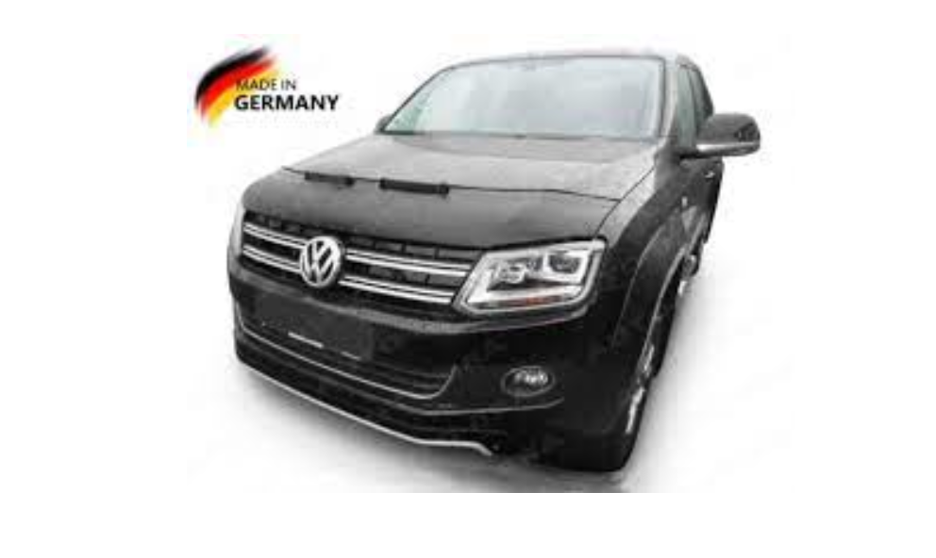


Available car data available but need to be processed for usability such as provide insights into vehicles that are listed for sales and to improve understanding of the second-hand car market dynamics.

